Slide 1
ECMAScript (ES6)
Presented by: s.quraishi

Slide 2
Introduction to ES6
JavaScript was invented by Branden Ecih in 1995 in Netscape.
Mocha – live script –JavaScript – ECMAScript
ECMAScript was created to standardize JavaScript.
ES6 is the 6th version of ECMAScript, it was published in 2015, and is also known as ECMAScript 2015.
1997
ES1
JavaScript
ECMA International
ECMAScript
1995
1997

Slide 3


Why we learn ES6?
Framework and Library Support
Compatibility with Modern Web Development
Modern JavaScript Development

Slide 4

Advantage of ES6
Enhanced syntax
Improved Developer productivity
Better support of OOP.
Modules for code organization

Slide 5
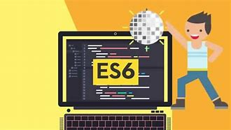
Disadvantage of ES6
Browser compatibility
Learning curve
Debugging Challenges
Tooling and Documentation Support

Slide 6


